Slide 1

Project
PTDA16
Web Scrape data from LinkedIn
Kartikeya Bhatia
Naman Sharma
Saurav Sagar Pandey
Greeshma Tom

Slide 2
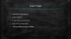
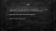
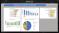



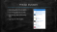


Content
AIM
Problem Statement
Challenges
Our Approach
Insights
Learnings
Result

Slide 3
AIM
Scrape data from professional networking platform Linkedin using python library called Beautifulsoup and collate information
Aggregate and manipulating data using SQL
Presenting data using excel

Slide 4
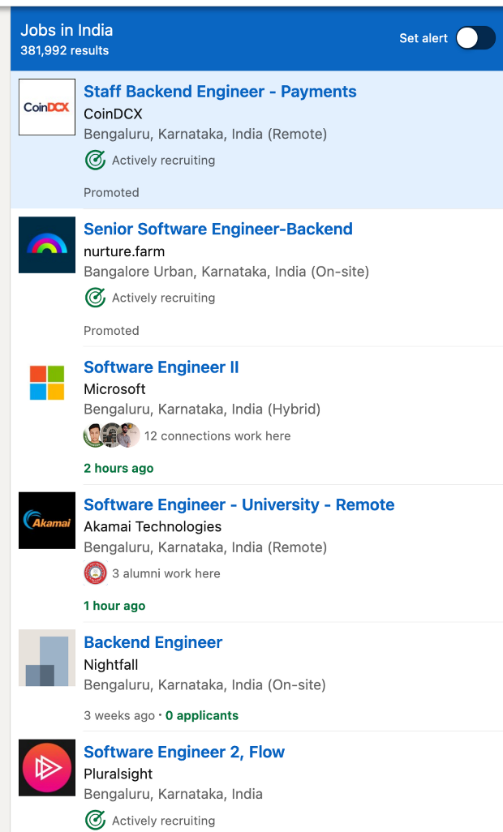
Problem Statement
Extracting data from LinkedIn
Converting data into csv files
Connecting data and cleaning data
Coming out with Insights

Slide 5
Challenges
Web scraping
Login in secure server
Automation
Extracting clean data
Correlating the data

Slide 6
Our Approach
Collecting Link first and then opening them one by one and clicking one by one and collecting data
Clicking on link one by one and collecting data
Cleaning data and connecting data in SQL and showing data in Excel

Slide 7
Insights
Count of jobs
Location
Designation
Different fields
Full time vs part time
Different company
Sum of jobs
Location
Company
Full time vs part time

Slide 8
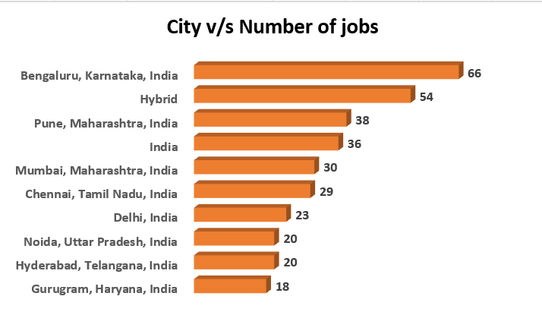
City v/s Number of jobs
Here we can see that most of the job vacancies are available in Bengaluru

Slide 9
Learnings
Selenium automation
web scraping
Login into secure server
Extracting clean data
Joining different type of data

Slide 10
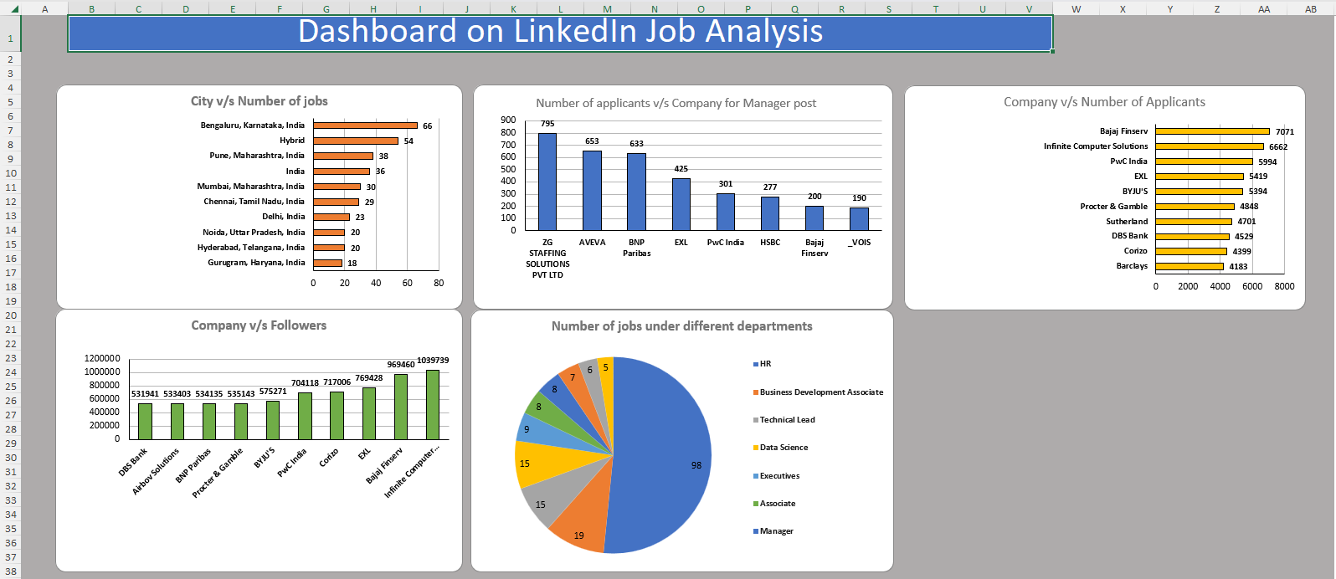
Result

